Slide 1

PowerPoint Slide Creation
Ms. Isuri Caldera

Slide 2

“Great speakers aren’t born, they are trained.”
Presenting is a skill…
developed through experience and training

Slide 3

PowerPoint Slide Preparation

Slide 4
Why use PPT for presentations?
Prompter for ideas
Backup for content
Give as handouts
Dump complex data
Impress the audience
Visualize ideas
Create key points
Support message
Hold interest
Get engagement
O
P

Slide 5
Design
Objectives
Audience
Key points
Plan the speech
Content
Formatting
Movement
Tech stuff
Stay active
Don’t read
Be the speech!
Planning
Execution

Slide 6



Content
Text
Graphics
Audio-visuals

Slide 7

Text
Font type, size and styles
Only phrases and words
Only key points
Minimum punctuation marks
Self-explanatory

Slide 8

Graphics
No watermarks
Low resolution (96 ppi) is fine
Size implies importance
May distract the audience

Slide 9

Audio-visuals
Short clips (10-20 seconds)
Crop longer clips (trim option)
Check file format
Insert the clip (embed)
Can adjust when to start, fading, looping etc.

Slide 10





Formatting – Objects
Size
Clarity
Simplicity
Consistency
Progression

Slide 11
Make it Big
Too Small
This is Arial 12
This is Arial 18
This is Arial 24
This is Arial 32
This is Arial 36
This is Arial 44

Slide 12
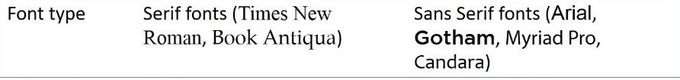
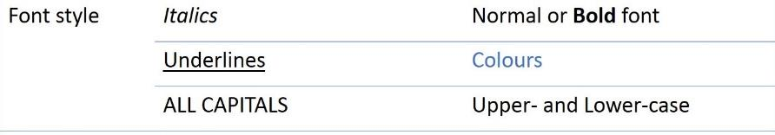

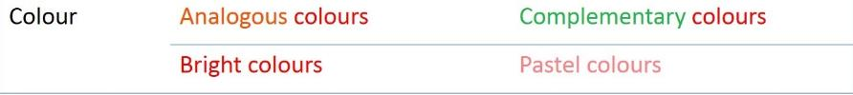
Make It Clear

Slide 13
Keep It Simple
Too many colours
Too Many ^{Fonts} and _{Styles}
The 6 x 7 rule
No more than 6 lines per slide
No more than 7 words per line

Slide 14
Instructional Technology: A complex integrated process involving people, procedures, ideas, devices, and organization, for analyzing problems and devising, implementing, evaluating, and managing solutions to those problems in situations in which learning is purposive and controlled (HMRS 5th ed.)
Instructional Technology: A process
involving people, procedures & tools
for solutions
to problems in learning
(HMRS 5th ed.)

Slide 15
 | Christ-church | Dunedin | Wellington
January | 11,532,234 | 14,123,654 | 3,034,564
February | 1,078,456 | 12,345,567 | 16,128,234
March | 17,234,778 | 6,567,123 | 16,034,786
April | 16,098,897 | 10,870,954 | 7,940,096
May | 8,036,897 | 10,345,394 | 14,856,456
June | 16,184,345 | 678,095 | 4,123,656
July | 8,890,345 | 15,347,934 | 18,885,786
August | 8,674,234 | 18,107,110 | 17,230,095
September | 4,032,045 | 18,923,239 | 9,950,498
October | 2,608,096 | 9,945,890 | 5,596,096
November | 5,864,034 | 478,023 | 6,678,125
December | 12,234,123 | 9,532,111 | 3,045,654
In 10⁶ | Christ-church | Dunedin | Wellington
January | 11 | 14 | 3
February | 1 | 12 | 16
March | 17 | 6 | 16
April | 16 | 10 | 7
May | 8 | 10 | 14
June | 16 | 0 | 4
July | 8 | 15 | 18
August | 8 | 18 | 17
September | 4 | 18 | 9
October | 2 | 9 | 5
November | 5 | 0 | 6
December | 12 | 9 | 3

Slide 17
Be Consistent
Differences draw attention
Consistency if the default rule
Differences draw attention
Differences may imply importance
Consistency if the default rule
Differences draw attention
Differences may imply importance
This tick draws attention
These differences distract!

Slide 18
Differences may imply importance
Consistency if the default rule
Differences draw attention
Differences may imply importance
Consistency is the default rule
Differences draw attention
Differences may imply importance
This implies importance
These differences are confusing!

Slide 19
Make it Progressive
Types of Instructional Tools
Discovery
Learning
Individual
Constructive
Tools
Social
Constructive
Tools
Guided
Inquiry
Informational Tools
Mode of Instruction
Individual
Instructive
Tools
Social
Communicative
Tools
Direct
Instruction
Individual
Pair
Group
Complexity of Interactions

Slide 20






Formatting - layout
Alignment
Proximity
Repetition
Contrast
Balance
White space

Slide 21
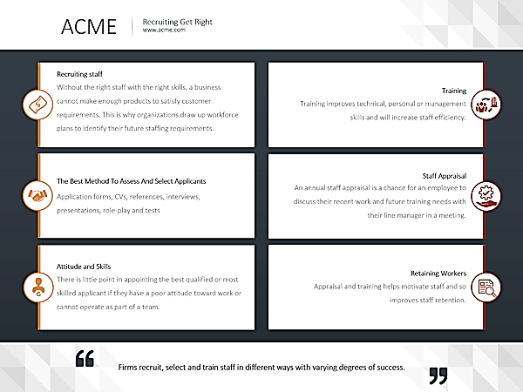
Alignment

Slide 22
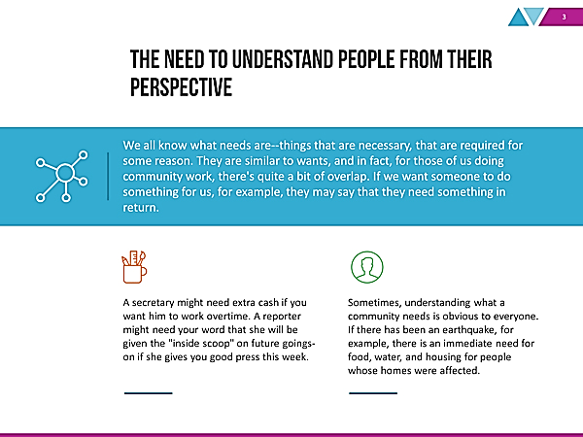
Proximity

Slide 23
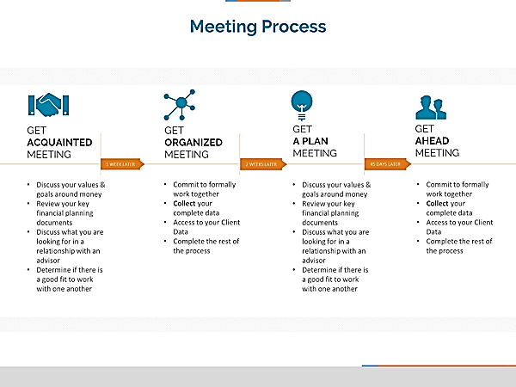
Repetition

Slide 24


Contrast

Slide 25
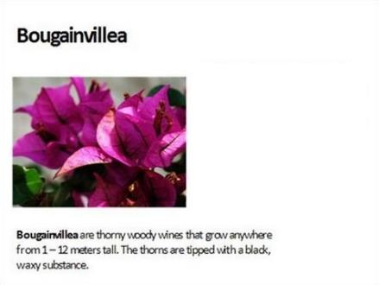
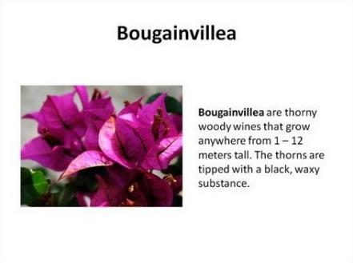
Balance

Slide 26

White space

Slide 27
QUESTIONS?

